Slide 1
Study Unit 3 Arrays and Plots

Slide 2
Array Management with NumPy

Slide 3
NumPy Package
Compound data such as lists, tuples, or dictionaries are one-dimensional.
Arrays should be used to store multidimensional data.
All values must be of the same type, typically numeric values or strings.
NumPy is the most common package in Python to work with arrays.

Slide 4
Install and Import NumPy Package
Use the import statement to load “numpy” package in our program.
The most common alias for “numpy” is “np”.
import numpy as np

Slide 5
Create Arrays
Use array() function to create n-dimensional NumPy arrays (ndarray).
Data in the array() function are stored in various regular Python lists.
Each list corresponds to a row of the array.
Number of elements in each list must be identical.
All lists in the array() function, separated by commas, must be wrapped by a pair of outer square brackets.
Each direction of an array is called an axis.
array_name = np.array([[list1_data1, list1_data2, …],
[list2_data1, list2_data2, …], …])

Slide 6
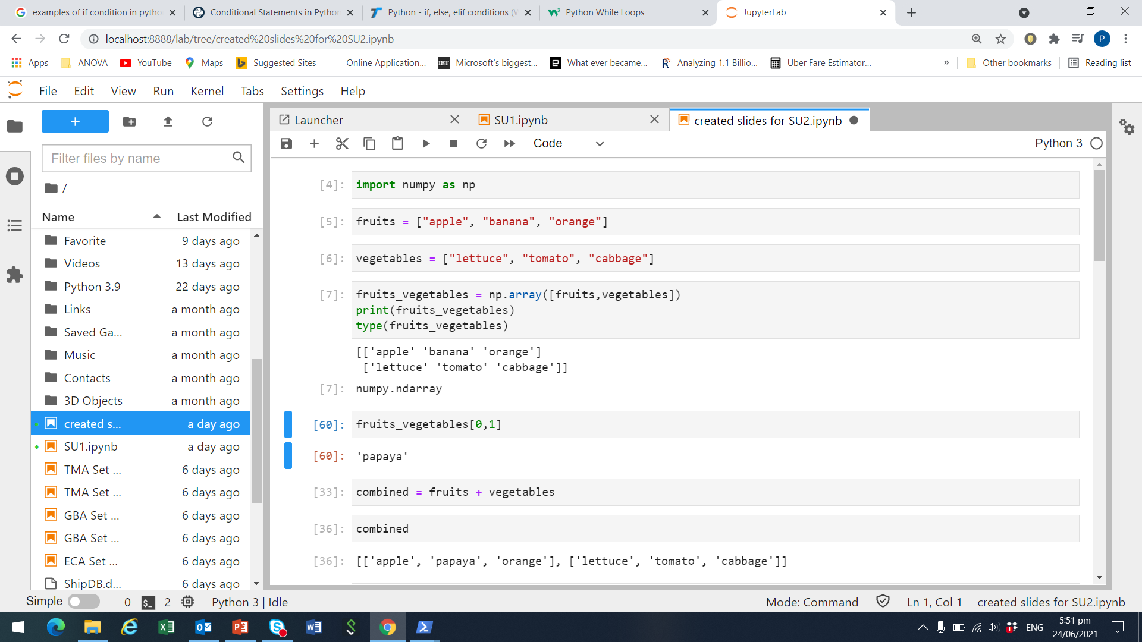
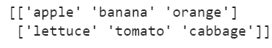
Example of 2 dimensional numpy array
Suppose we have two lists, fruits and vegetables
Combine fruits and vegetables into one numpy array
Print the array to take a look at its contents

Slide 7
Subset Arrays
Use index operator [] to access elements of an array.
Two ways to subset an array:
By index: Including multiple indexing, open-end indexing, negative indexing.
Boolean masking: Values of an array that fulfil certain conditions are selected in the subset.
Syntax for subsetting two-dimensional arrays:
The order of the indices in the index operator must follow the sequence of the axes (dimension).
array_name[row_index, column_index]

Slide 8

Subsetting example
In our example, we created fruits_vegetables as a numpy array.
Row index: 0 is the fruits list, 1 is the vegetables list
Column index: 0 is the 1st element in a given list, 1 is the 2nd element…
To get ‘banana’ from fruits_vegetables, we need
row index = 0 (i.e., fruits list) and,
column index = 1 (i.e., 2nd element)

Slide 9
Array Properties
Check properties of an array using some NumPy functions and methods:
type(array_name)
array_name.ndim
array_name.shape
array_name.size
array_name.dtype

Slide 10
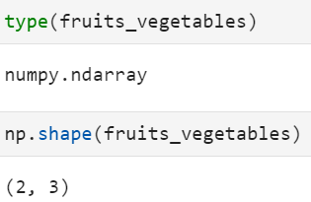
Example of array properties

Slide 11
Work with NumPy Arrays
NumPy provides various functions to us to work with arrays.
Each function deals with specific type of values in the array.
For instance, log() and sqrt() are only applicable to numeric arrays.
Functions like strip() and upper() are specifically designed for strings arrays.
Each function may have effect on different axes of the array.
Below are some examples of some frequently used NumPy functions.
Function | Description
percentile() | Return row, column, or array percentile
mean() | Return row, column, or array mean
exp() | Return exponential
random.ranf() | Return array with random floats in the interval [0, 1)

Slide 12
Activity for Study Unit 3
1) Compute the statistics for each column of the housing data
Extract the values for each column
Compute the min, max, mean, median and standard deviation of each column in the array
CRIM min = 0.00632 , max = 88.9762 , std = 8.593 , mean= 3.614 , median = 0.257
ZN min = 0.0 , max = 100.0 , std = 23.299 , mean= 11.364 , median = 0.0
INDUS min = 0.46 , max = 27.74 , std = 6.854 , mean= 11.137 , median = 9.69
CHAS min = 0.0 , max = 1.0 , std = 0.254 , mean= 0.069 , median = 0.0
NOX min = 0.385 , max = 0.871 , std = 0.116 , mean= 0.555 , median = 0.538
RM min = 3.561 , max = 8.78 , std = 0.702 , mean= 6.285 , median = 6.208
AGE min = 2.9 , max = 100.0 , std = 28.121 , mean= 68.575 , median = 77.5
DIS min = 1.1296 , max = 12.1265 , std = 2.104 , mean= 3.795 , median = 3.207
RAD min = 1.0 , max = 24.0 , std = 8.699 , mean= 9.549 , median = 5.0
TAX min = 187.0 , max = 711.0 , std = 168.37 , mean= 408.237 , median = 330.0
PTRATIO min = 12.6 , max = 22.0 , std = 2.163 , mean= 18.456 , median = 19.05
B min = 0.32 , max = 396.9 , std = 91.205 , mean= 356.674 , median = 391.44
LSTAT min = 1.73 , max = 37.97 , std = 7.134 , mean= 12.653 , median = 11.36

Slide 13
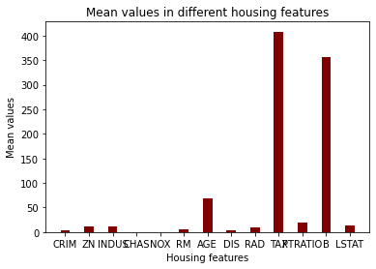
Activity for Study Unit 3
2) Plot a bar graph showing the mean values of houses in different housing features as shown

Slide 14
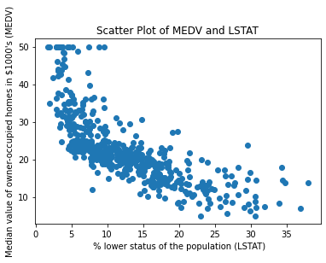
Activity for Study Unit 3
3) Plot a scatter plot showing the % lower status of the population (LSTAT) and Median value of owner-occupied homes in $1000's (MEDV)

Slide 15
Discussion
When is it more sensible to use arrays instead of tuples, lists, or dictionaries? And when is it vice versa?
Why do some NumPy functions require the whole axis or array for its process and why some of them do not?

Slide 16
Plotting with matplotlib

Slide 17
matplotlib Package
“matplotlib” is the most common visualisation package for Python.
The sub-package “pyplot” contains all functions and plot types we need here, e.g., bar chart, histogram, scatter plot, etc.
Use the following syntax to import “pyplot” into a program:
import matplotlib.pyplot as plt

Slide 18
Create Plots
Use plot() function to create simple line plot.
The function parameters control:
x, y: lists of the x-axis and y-axis values
color: colour of the line
linestyle, linewidth: formatting options of the line.
marker: style of the data points, e.g., point, circle, square, etc.
markerfacecolor, markeredgecolor and markersize: colour and size of data points.
Refer to https://matplotlib.org/api/_as_gen/matplotlib.pyplot.plot.html for more arguments of the plot() function.
plt.plot(x, y, color, linestyle, linewidth, marker,
markerfacecolor, markeredgecolor, markersize)

Slide 19
Other Plot Options
Apply .xlabel() and .ylabel() methods to add labels to both axis.
Set a title to the current plot by title().
We can define the text and location of the labels on each tick of both axes.
Python waits for show() to display all figures.
plt.xlabel("My X-Label String")
plt.ylabel("My Y-Label String")
plt.title("My Plot Title")
plt.xticks(ticks, labels, rotation)
plt.yticks(ticks, labels, rotation)
plt.show()

Slide 20
Histogram
Histogram shows the distribution of a variable.
With the hist() function, we can control
number of bins,
range of values,
chart’s orientation,
width of the bars,
position of the bars (between two ticks or on top of a tick),
colour of the bars.
plt.hist(x, bins = None, range = None, align = "mid", orientation = "vertical", rwidth = None, color = None)

Slide 21
Scatter Plot
Scatter plots are used to study the correlation between two variables.
The parameters of the scatter() function control
values of x and y,
colour and style of the markers,
width and colour of the markers’ edge.
plt.scatter(x, y, color = None, marker = None, linewidths = None, edgecolors = None)

Slide 22
Activity
Revisit the earlier plotting exercises:
Find at least one modification to improve each of any two plots done earlier
Discuss what you have found

Slide 23
Discussion
What are the additional matplotlib functions that can help us to improve the visualisation of our charts?
Name some situations in which a line chart, or a histogram, or a scatter plot is more suitable than other plot types for data visualisation.

